Slide 1
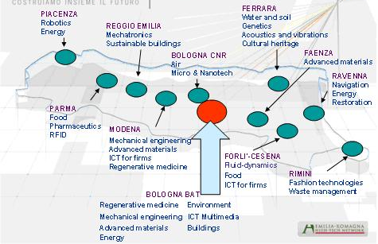
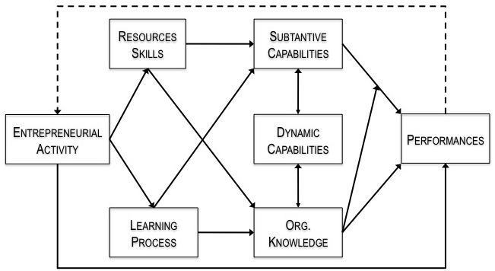
The Role of Innovation Intermediaries in the Regional Innovation System Andrea Cocchi – Newcastle University Business School
RIS as a context
Institutional infrastructure (set of economic, political and organizational relationships), defined by a specific geographical area. Its aim it to support the development of the region through innovation, through the generation and management of a collective learning process among actors and institutions
PROBLEMS
For Policy Makers: how we can expect to manage such a complex phenomenon without knowing how system’s institutions and actors are actually organised and behave?
For Scholars: how we can expect to understand the regional innovation dynamics profiting from a static, stereotyped representation of agents and institutions?
Intermediaries in an I.S. (van Lente et al. 2003)
OBJECT OF ANALYSIS
On a specific family of actors: Innovation Intermediaries
“An organization or body that acts an agent or broker in any aspect of the innovation process between two or more parties.”
(Howells, 2006)
RESEARCH QUESTIONS
What is the nature of the relationship between Intermediary’s activities and Regional Innovation System?
How this relationship is evolving?
How the activities of Intermediaries are organised?
Can these practices be subsumed by a specific model or behaviour characterising these actors?
RESEARCH METHOD
Comparative case study between Emilia-Romagna and Beden-Wurttemberg
TECHNOPOLES IN EMILIA-ROMAGNA
FOCUS
On agency: “the capacity, condition, or state of acting or of exerting power” (Webster Dictionary) ➔ Entrepreneurship or Entrepreneurial Orientation of Innovation Intermediaries
FUNCTIONS AND ACTIVITIES OF INTERMEDIARIES (Howells, 2006)
Foresight and diagnostics
Scanning and information processing
Knowledge processing, generation, and combination
Gate-keeping and brokering
Testing, validation, and training
Accreditation and standards
Regulation and arbitration
Protecting the results
Commercializing and exploiting the outcomes
Assessment and evaluation
INTERPRETATIVE MODEL (Zahara et al. 2006)

